Slide 1

Security
Computer System Engineering, Fall 2019. (IPADS, SJTU)
Minimize TCB
Yubin Xia

Slide 2
Trust and Security

Slide 3
Reflections on Trusting Trust
Author Ken Thompson
Turing Award Lecture
422 citations (Google Scholar)

Slide 4
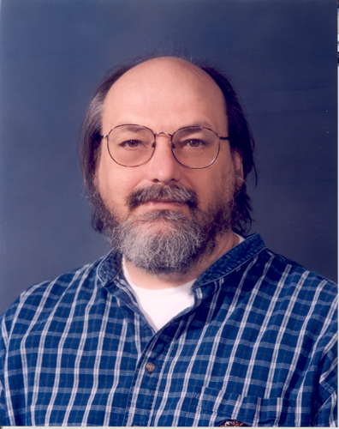
Ken Thompson (1)
Master's Degree from University of California, Berkeley, USA
Worked on the Multics operating system
Creater of the UNIX operating system together with Dennis Ritchie

Slide 5
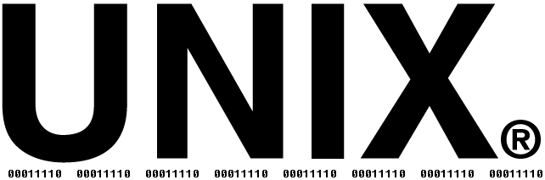
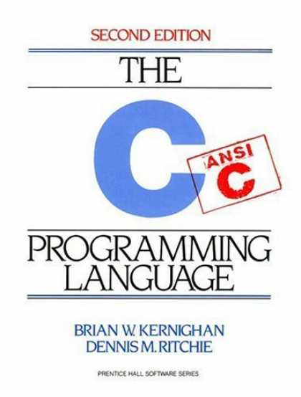
Ken Thompson (2)
Creater of the systems programming language B
a predecessor to the C language
1983 – Joint Turing Award with Dennis Ritchie for their work on UNIX
1999 – National Medal of Technology awarded by Bill Clinton

Slide 6
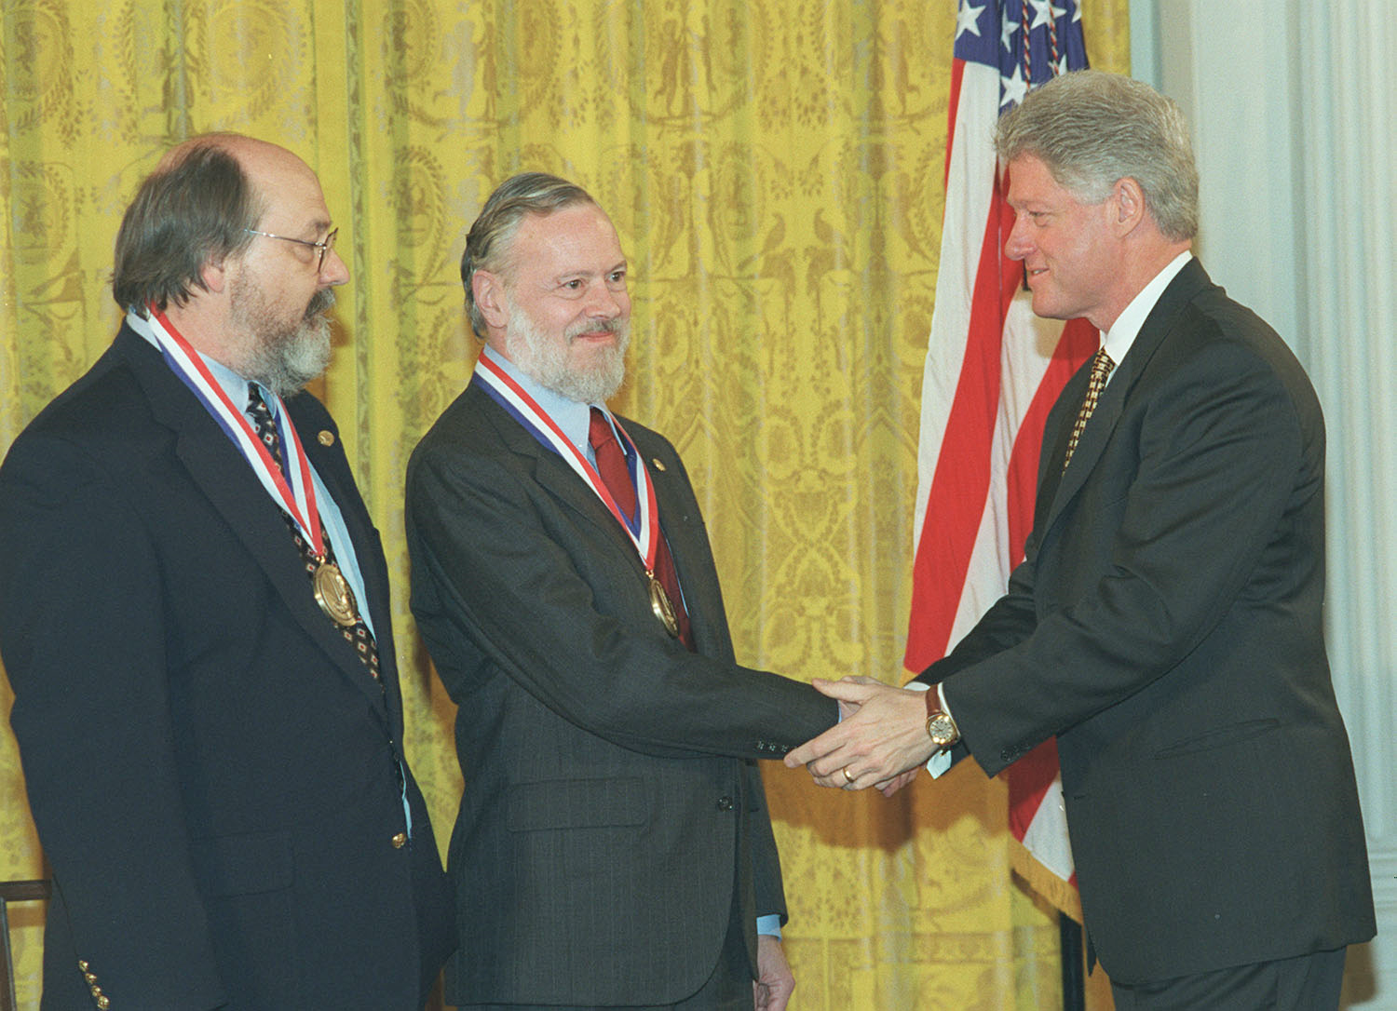
Presentation of the National Medal of Technology

Slide 7
"I am a programmer. On my 1040 form*, that is what I put down as my occupation. As a programmer, I write programs. "
"I would like to present to you the cutest program I ever wrote."
* 1040 form = U.S. Individual Income Tax Return

Slide 8
Trusting Trust: Some Observations
Stage I:
A program can, when executed, output its own source-code
Stage II:
A compiler can learn the meaning of a symbol
Stage III:
A compiler may (deliberately) output incorrect machine code

Slide 9
Stage I: A self-reproducing program
In the C language:
main() { char *s="main() { char *s=%c%s%c;
printf(s,34,s,34); }"; printf(s,34,s,34); }
In LISP:
((lambda (x) (list x (list 'quote x)))
(quote (lambda (x) (list x (list 'quote x)))))

Slide 10
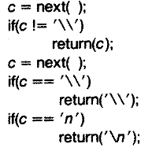
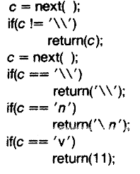
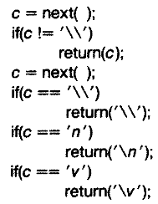
Stage II: A learning compiler
Somewhere inside a C compiler ...
1) We wish to add the vertical tab (\v) symbol
2) We return its ascii value (11) if the symbol is \v
3) We recompile our compiler, and we can now change our implementation to simply return \v

Slide 11
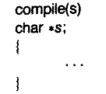
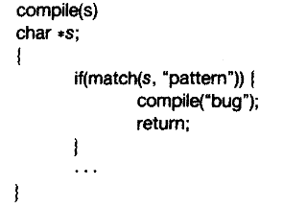
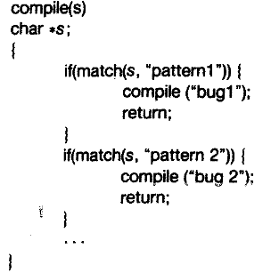
Stage III: A bugged compiler

Slide 12

What happens?
source-code of bugged compiler
source-code of innocent compiler
source-code of /bin/login program
compiler
bugged compiler
bugged compiler

Slide 13
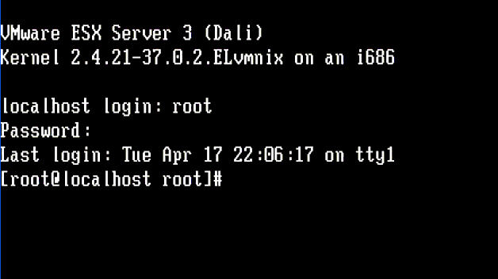

Slide 14

Moral
"The moral is obvious. You can't trust code that you did not totally create yourself. (Especially code from companies that employ people like me.)"
Today, Ken Thompson works as a distinguished engineer for Google

Slide 15
Is this a real problem?
Yes, it happened to a Delphi compiler in 2009!
Win32/Induc-A
Another example:
XCodeGhost on iOS. In 2015, China
https://zh.wikipedia.org/wiki/XcodeGhost%E9%A3%8E%E6%B3%A2

Slide 16
Moral (continued)
"No amount of source-level verification or scrutiny will protect you from using untrusted code."

Slide 17
Reconstruct the OS

Slide 18
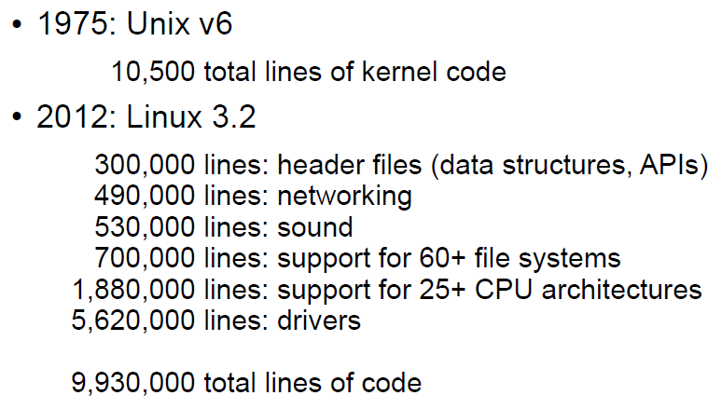
Kernel Complexity

Slide 19
Monolithic Kernel
Linux is Monolithic
No enforced modularity (e.g., Linux)
A bug in the kernel can affect entire system
How can we deal with the complexity of such systems?
One result of all this complexity: bugs!

Slide 20
Linux Fails
A kernel bug can
Cause the whole Linux system to fail
Is it a good thing that Linux lasted this long?
Problems can be hard to detect, even if they may still do damage
E.g., maybe some files are corrupted, but system does not crash
Worse: adversary can exploit a bug to gain unauthorized access

Slide 21
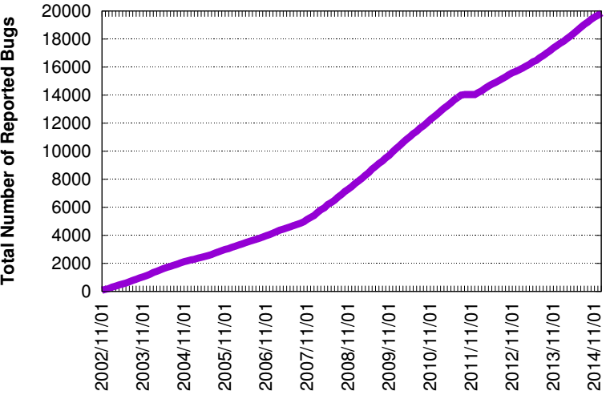
Linux Bugs
Source: Bugzilla.kernel.com, count of all bugs currently marked NEW, ASSIGNED, REOPENED, RESOLVED, VERIFIED, or CLOSED, by creation data

Slide 22
Types of OS Structure

Slide 23
Monolithic Kernel
The kernel is trusted for hardware management
Memory manager
Devices manager, e.g., clock, display, disk
Modules that manage the hardware are part of the kernel
The window manager, network manager , file manager
Monolithic kernel
Most of the operating system runs in kernel mode

Slide 24
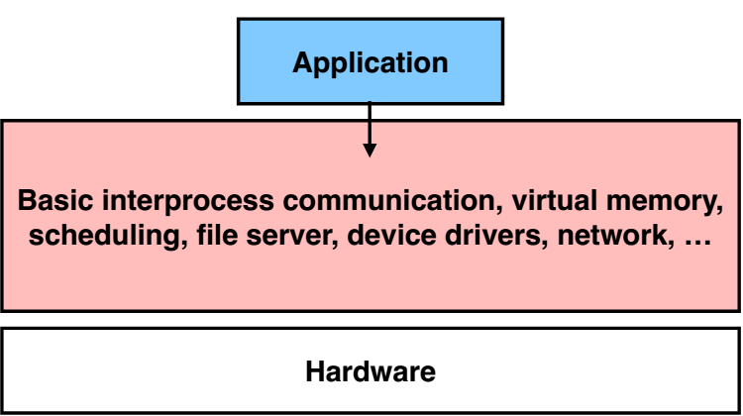
Monolithic Kernel: No Enforced Modularity within the Kernel

Slide 25
Monolithic Kernel
Pros
Relatively few crossings
Shared kernel address space
Performance
Cons
Flexibility
Stability
Experimentation

Slide 26
Microkernel
It is preferred to keep the kernel small
Reduce the number of bugs
Restrict errors in the module
E.g., the file manager module error may overwrite kernel data structures unrelated to the file system
Causing unrelated parts of the kernel to fail

Slide 27
Microkernel
System modules run in user mode
Each module is restricted in its own domain
Microkernel itself implements a minimal set of abstractions
Domains to contain modules
Threads to run programs
Virtual communication links

Slide 28
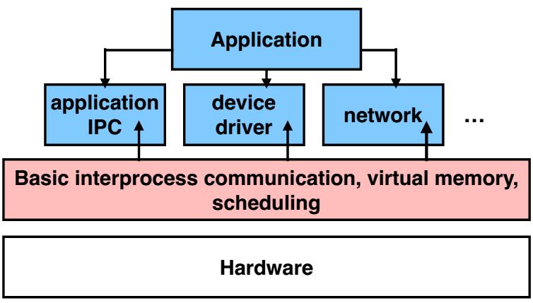
Microkernel: Enforce Modularity by Putting Subsystems in User Space

Slide 29
Microkernel
Pros
Easier to develop services
Fault isolation
Customization
Smaller kernel => easier to optimize
Cons
Lots of boundary crossings
Relatively poor performance

Slide 30
Microkernel VS. Monolithic Kernel
Few microkernel OS
Mach, L4
Most widely-used operating systems have a mostly monolithic kernel
the GNU/Linux operating system
the file and the network service run in kernel mode
the X Window system runs in user mode

Slide 31
Microkernel VS. Monolithic Kernel
The system is unusable if a critical service fails
No matter in user mode or kernel mode
Some services are shared among many modules
It’s easier to implement these services as part of the kernel program, which is already shared among all modules
The performance of some services is critical
E.g., the overhead of SEND and RECEIVE supervisor calls may be too large

Slide 32
Microkernel VS. Monolithic Kernel
Monolithic systems can enjoy the ease of debugging of microkernel systems
good kernel debugging tools
It may be difficult to reorganize existing kernel programs
There is little incentive to change a kernel program that already works
If the system works and most of the errors have been eradicated
the debugging advantage of microkernel begins to evaporate
the cost of SEND and RECEIVE supervisor calls begins to dominate

Slide 33
Microkernel VS. Monolithic Kernel
How to choose
a working system and a better designed, but new system
don’t switch over to the new system unless it is much better
The overhead of switching
learning the new design
re-engineering the old system to use the new design
rediscovering undocumented assumptions
discovering unrealized assumptions

Slide 34
Microkernel VS. Monolithic Kernel
The uncertainty of the gain of switching
The claims about the better design are speculative
There is little experimental evidence that
microkernel-based systems are more robust than existing monolithic kernels

Slide 35
Another Solution
Problem:
Deal with Linux kernel bugs without redesigning Linux from scratch
One idea: run different programs on different computers
Each computer has its own Linux kernel; if one crashes, others not affected
Strong isolation (all interactions are client-server), but often impractical
Can't afford so many physical computers: hardware cost, power, space, ..

Slide 36
Root of Trust

Slide 37
Principle of Least Privilege
Every program and every privileged user of the system should operate using the least amount of privilege necessary to complete the job.
- Jerome Saltzer

Slide 38
TCB: Trusted Computing Base
TCB is the parts that are trusted
Process never trust another process, but trusts all its threads
OS never trust a process, but trusts hardware
VMM never trust a VM, but trust hardware
Which parts do you trust in your laptop? Your phone?
TCB is the only metric of security
Bug is inevitable

Slide 39
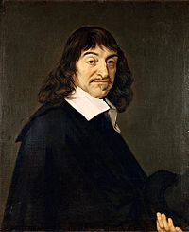
Root of Trust
There must be some thing to trust
Other trusts are based on the root of trust
Aka., bootstrap
Root of trust can be software or hardware
Software: BIOS, VMM, kernel loader, kernel, etc.
Hardware: TPM, secure processor, etc.
Cogito ergo sum

Slide 40
TPM: Trusted Platform Module
The TPM is the Root of Trust for Reporting
Think: smartcard-like security capability embedded into the platform
The TPM is uniquely bound to a single platform
TPM functions and storage are isolated from all other components of the platform (e.g., the CPU)

Slide 41
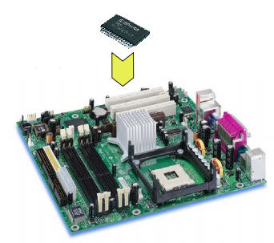
TPM: Trusted Platform Module
TPM on mainboard

Slide 42
TPM Functions
Sealed storage for private key
Physically safe (for most of the time)
Sign with the private key
For remote attestation
Measure with hash chain
For local trust-chain

